Slide 1
APPLIED COMPUTER SCIENCE AND ARTIFICIAL INTELLIGENCE 019_AMG: “PERFORMANCE MONITORING”
STATISTICS: PROJECT PRESENTATION

Slide 2
PROJECT CONTEXT
Nowadays, we are really full of Computer Devices. Every one is peculiar in its own, but its behaviour is almost always dictated by its OPERATING SYSTEM. Here, we will focus mainly in Windows Pc’s.
GENERAL OBJECTIVE:
In this Statistics Journey, our Main Objective is to come up with a detailed Analysis of some Computers' Components.
SUPPORT TOOL:
We made use of the Performance Monitoring System, an analytic tool through which we have collected some data about some Computers' Components during the execution of some pre-established tasks.
COMPONENTS:
To carry on our analysis we are going to use data about these five principal component of a PC:
Processor
Memory
Physical Disk
Cache
Battery

Slide 3
PROJECT JOURNEY
PROCESSOR
01
MEMORY & PHYSICAL DISK
02
CACHE AND FINAL COMPARISON
03
Work-Idle Clustering, Deep Dive into Performances (Time & Accuracy), Best Algorithm Choice, Device Comparison
Page Faults and Cache Faults Analysis: Bootstrap & T-Test & Physical Disk Linear Regression
Linear Regression with Cook Distance & Leverage Adjustments, Final Comparison with Correlation Matrix

Slide 4
01
PROCESSOR
Work-Idle Clustering, Deep Dive into Performances (Time-Accuracy), Best Algorithm Choice, Device Comparison

Slide 5
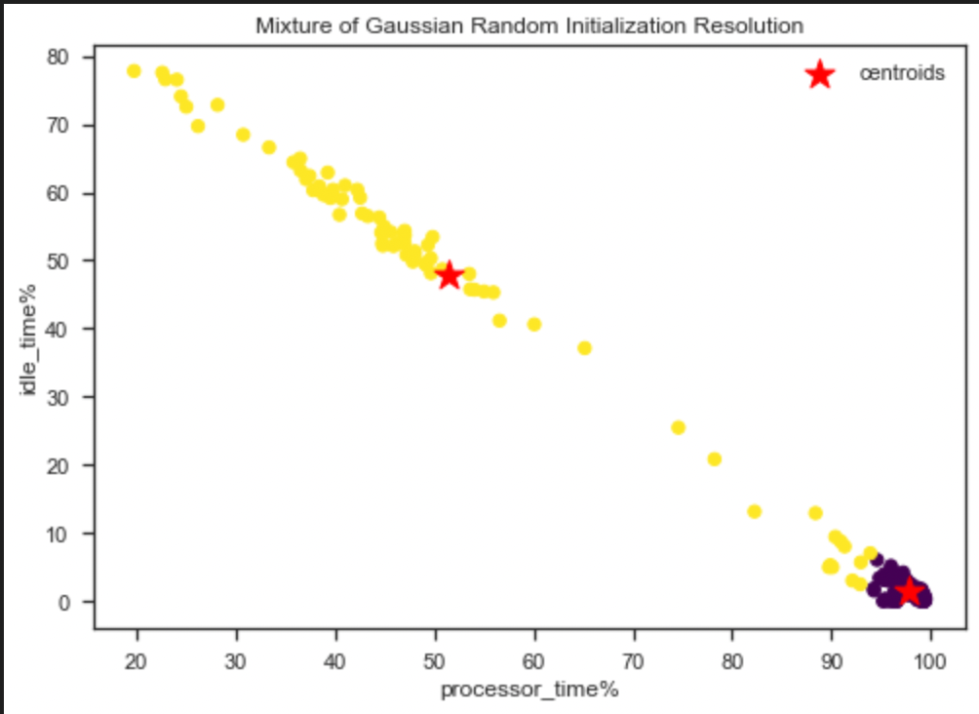
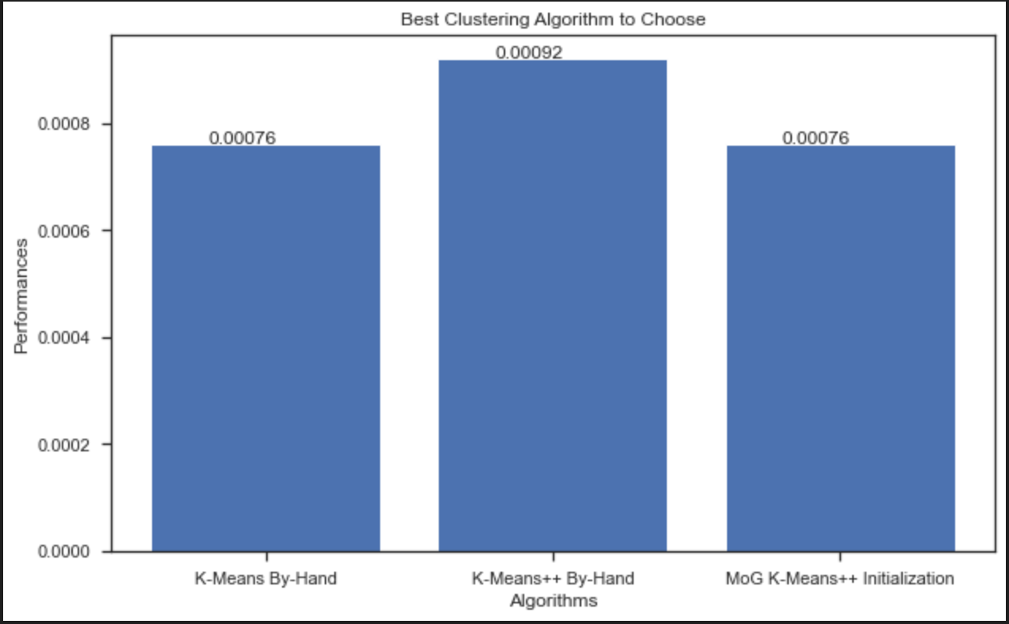
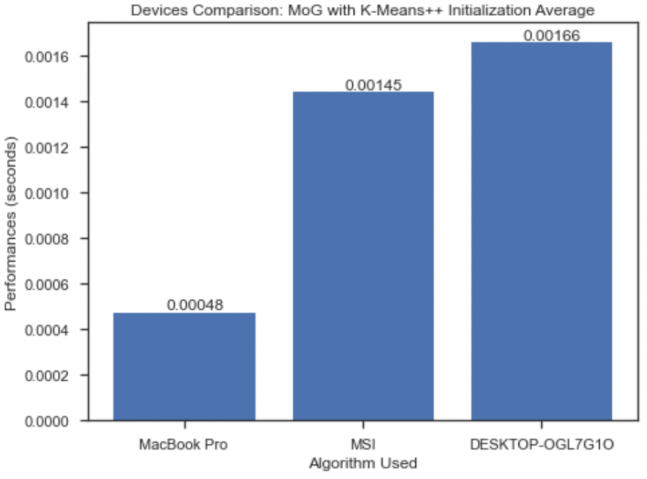
TASK EXPLANATION
The Processor is the first Component we are going to study. More commonly known as CPU (Central Processing Unit) is the logical and physical unit or subsystem that oversees the functionalities of a computer ( Brain ).
TASKS:
In this first part of the Statistics Journey, we are going to perform on the CPU the following:
1.1 : Clustering Idle VS Working & Focus on Performances: Best Algorithm Choice
1.2: Performances Devices Comparison

Slide 6
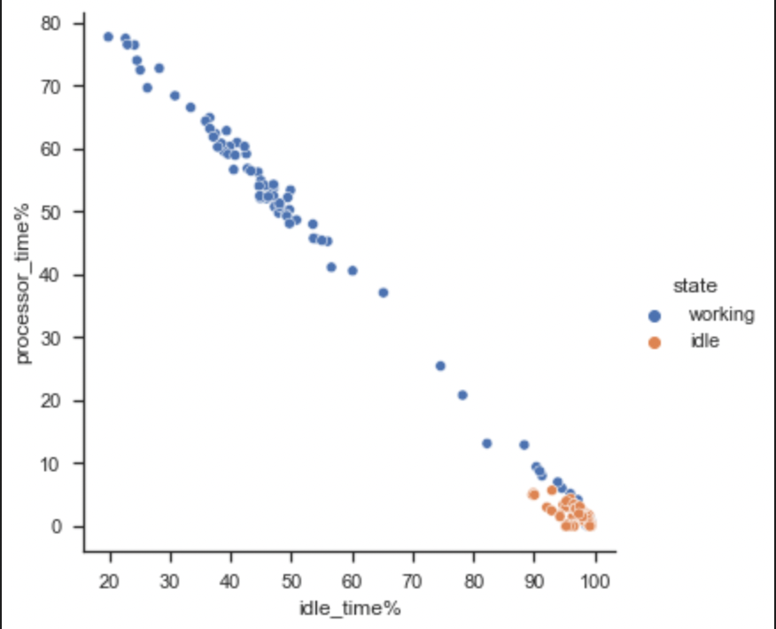
1.1: Clustering Idle VS Working
INTRODUCTION:
We gathered data in such a way that the Pc could have been only in two main steps:
Idle State: The Pcs were switched on, but no task was executed on them (idle_time%).
Working State: The Pcs were Training a ML Model (processor_time%).
As a small digression, an OS must aim to have an High CPU Usage ( processor_time% ).
OBJECTIVE:
Find a distinction in the data we have been collected, in such a way to be able to predict the state of new data in input, without knowing its State previously.
Moreover, we aim to select the Best Algorithm depending on the Time
and Accuracy Performances.
DATA GATHERING:
We let our PCs to be Monitored during the two cases described above.
ADDITIONAL COMMENTS:
Note that, since we have gathered the data by our own, we are also able
to know what are the Working and Idle Samples (we have Labels !).

Slide 7
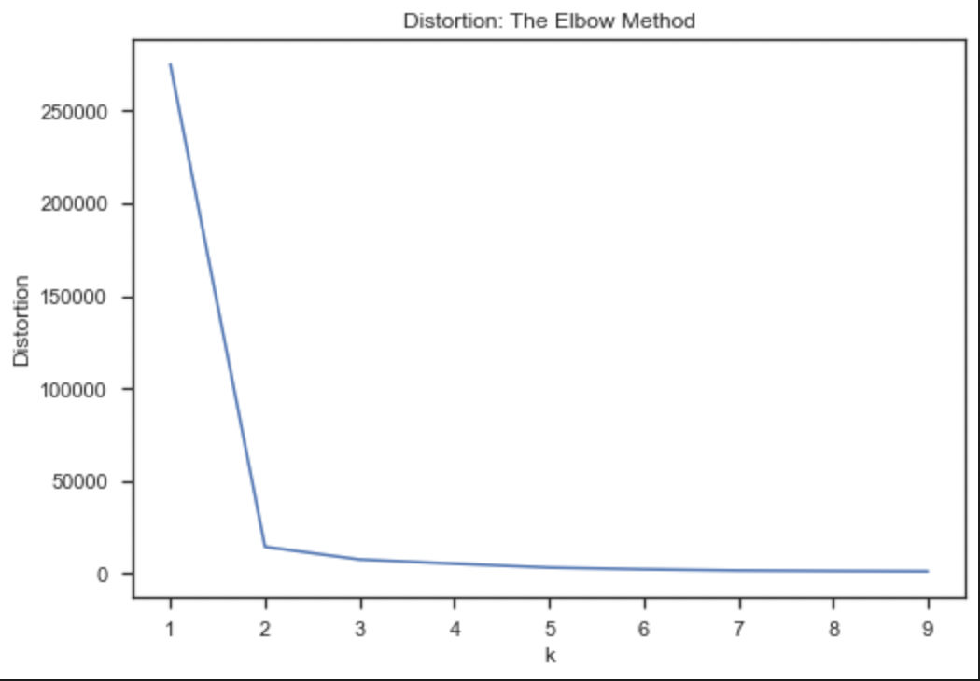
1.1: Clustering Idle VS Working
1.1.1: K-MEANS
1.1.1.1: PRE-PROCESSING: APPLYING THE ELBOW METHOD SUPPORT TOOL
Application of the Elbow Method as Pre-Processing Step, in order to find out the Best Number of Clusters that we are going to use in the Implemented Algorithms. (Cost Function = Distortion, sum of squared distances from each point to its center).
RESULT:
As result, we obtain that the “Elbow”, namely the point
of inflection on the curve, takes the best value at K = 2.
This would be the number of clusters we have chosen
for K-Means & K-Means++.

Slide 8
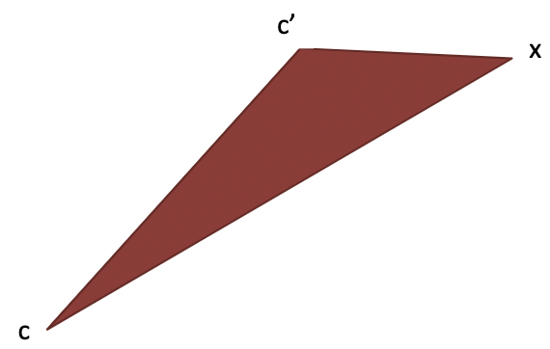
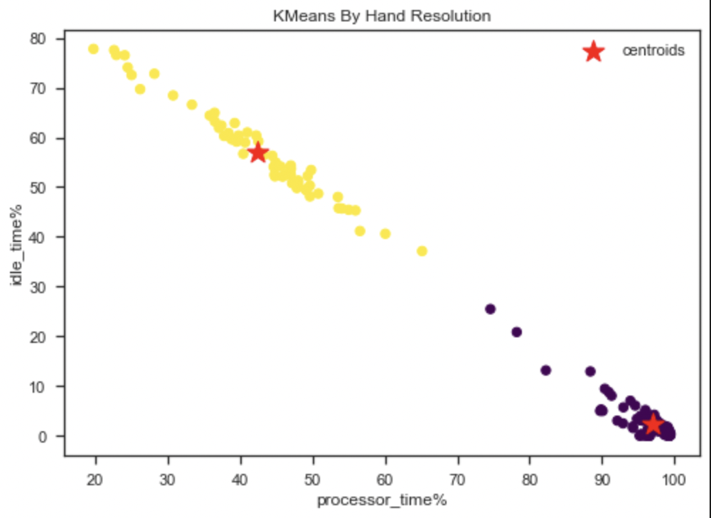
1.1: Clustering Idle VS Working
1.1.1.2: K-MEANS CLUSTERING: DIFFERENT VERSIONS APPLICATIONS
For the K-Means Clustering, we have applied three different versions of it:
K-Means Lloyd Algorithm: Application of the standard K-Means Naïve version.
K-Means Elkan Algorithm: Application of the K-Means more-advanced version. Points usually stay in the same
clusters after a few iterations. It reduces the distance computations by applying the Triangle’s
Inequality.
K-Means By-Hand Algorithm: Implementation of a By-Hand K-Means Version.
RESULT
We are now able to correctly distinguish the two clusters, and
possibly predict the label for new incoming samples.
QUESTION
Why Clusters are so elongated in shape?
ANSWER
Because we have Monitored different Pcs on the same Slice of time,
during a ML Training. Possible difference in Pcs Speed !

Slide 9

1.1: Clustering Idle VS Working
1.1.2: K-MEANS++
1.1.2.1: K-MEANS CLUSTERING: DIFFERENT VERSIONS APPLICATIONS
For the K-Means++ Clustering, we have applied three different versions of it:
K-Means++ Lloyd Algorithm: Application of the standard K-Means++ Naïve version.
K-Means++ Elkan Algorithm: Application of the K-Means++ more-advanced version. Points usually stay in the same
clusters after a few iterations. It reduces the distance computations by applying the Inequality’s Triangle
Inequality.
K-Means++ By-Hand Algorithm: Implementation of a By-Hand K-Means++ Version.
IDEA
K-Means++ is a smart centroid initialization technique that differs only w.r.t.
standard K-Means on the Initialization step:
Pick the First Centroid point Randomly.
Initialize the others using the Furthest-First Heuristic.

Slide 10
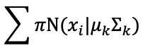
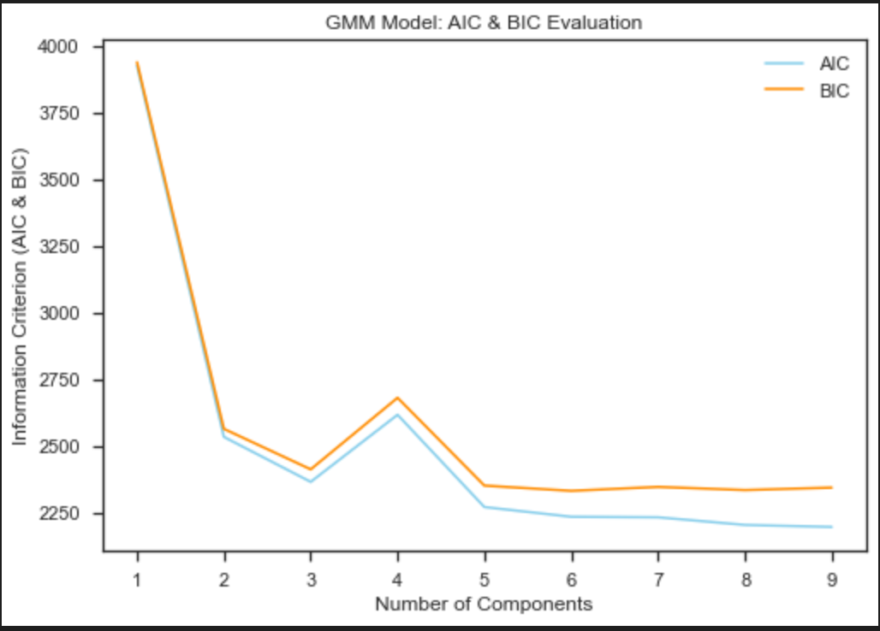

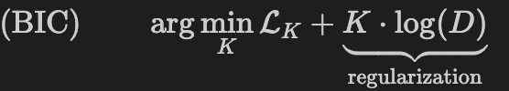
1.1: Clustering Idle VS Working
1.1.3 GAUSSIAN MIXTURE MODEL (GMM)
Application of another approach, to try to reach a better Classification, using the Gaussian Mixture Model clustering, a.k.a. Soft Clustering, since it uses a Probabilistic Approach, w.r.t. the Deterministic
Approach of the K-Means (Hard Clustering). The model is based on the Multivariate
Gaussian Distribution where x is a data points vector, μ is a vector of mean of each cluster,
and Σ is a covariance matrix and pi is the weight of the Gaussian. GMM is able to analyse More
Complex Data and it handles better Outliers.
1.1.3.1: AIC AND BIC EVALUATIONS ON GMM
Performing the AIC & BIC Evaluations with GMM on our Dataset, in
order to find out the best number of Gaussians (components) to use.
We choose to use the two main Information Criterions.
RESULT:
As conclusion of this Evaluation, we can see that both using the AIC
and BIC, the best number of components (Gaussians) in our model,
seems to be n_components = 2.

Slide 11
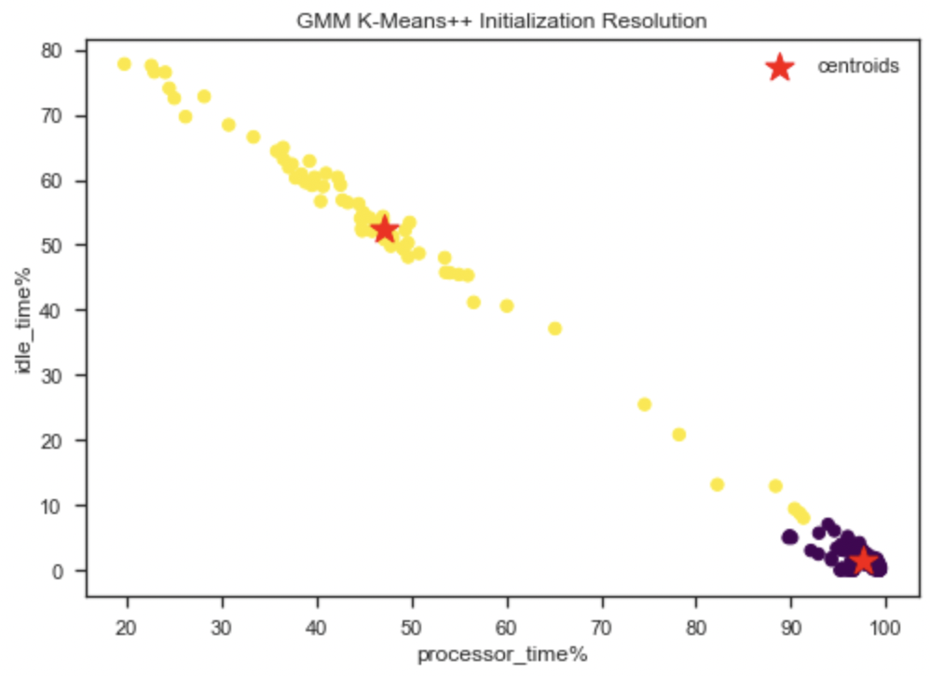
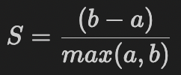
1.1: Clustering Idle VS Working
1.1.3.2: GMM CLUSTERING: DIFFERENT VERSION APPLICATIONS:
For the GMM Clustering, we have applied two different versions of it:
GMM Algorithm with Random Initialization: Application of the Naïve Implementation with Random Init.
GMM Algorithm with K-Means++ Initialization: Application of the Optimized version of the GMM.
1.1.4: SILOUHETTE COEFFIENT
Evaluation of the Quality of Clusters created using Clustering Algorithms, in
terms of how well samples are clustered with other samples that are similar to
each other. It is used to measure how dense and well-separated the clusters
are. We have that:
Mean Intra-Cluster Distance: Mean distance between the observation
and all other data points in the same cluster (denoted by a).
Mean Nearest-Cluster Distance: Mean distance between the observation and all other
data points of the next nearest cluster (denoted by b).

Slide 12
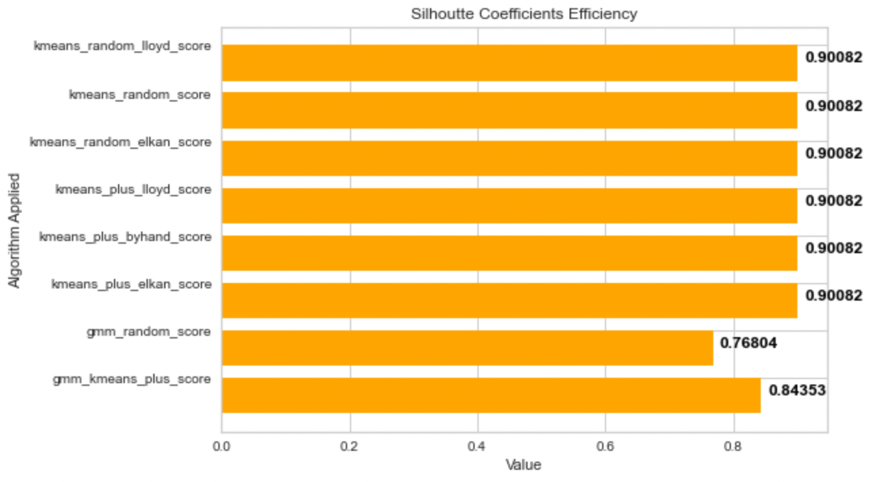
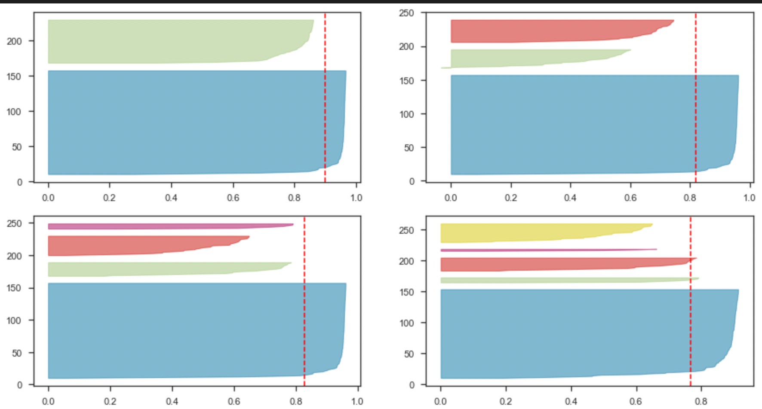
1.1: Clustering Idle VS Working
RESULT:
Computation of the Silouhette Score for each of the Clustering Algorithm
Implementation. The more the Score is towards 1, the more the Cluster is
dense and well separated. If towards 0, we have overlapping clusters. As
result, we have obtained that the K-Means implementations Clusters are
better w.r.t the GMM.
1.1.4.2: SILOUHETTE PLOT
Silhouette Coefficient is also used as method for selecting the optimal
value K (no. of cluster). We will use the Silhouette Plot to confirm the choice we have done using the Elbow Method.
RESULT: It turns out that the value 3, 4 and 5 are Suboptimal(Clusters with
below Average Silhouette Scores and Wide fluctuations in size)
Plots.
The value clusters = 2 is the Optimal One.

Slide 13
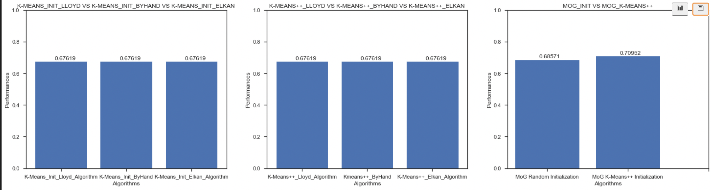
1.1: Clustering Idle VS Working
1.1.5: ACCURACY PERFORMANCES: ALGORITHM COMPARISON
Implementation of a By-Hand Accuracy Score. We can do this, because we have also the Labels since we have collected data by our own and we know what data are about the Idle State and what are about the Working State. RESULT:
The result of our study is that both all K-Means and K-Means++ Implementations returns the same score, whilst the GMM Implementations return a slightly higher Accuracy Score, with the GMM Implementation using K-Means++ as Initialization reach ~71% of accuracy (w.r.t. the ~69% of GMM with Random Initialization and ~68% of K-Means and K-Means++ Implementation).

Slide 14
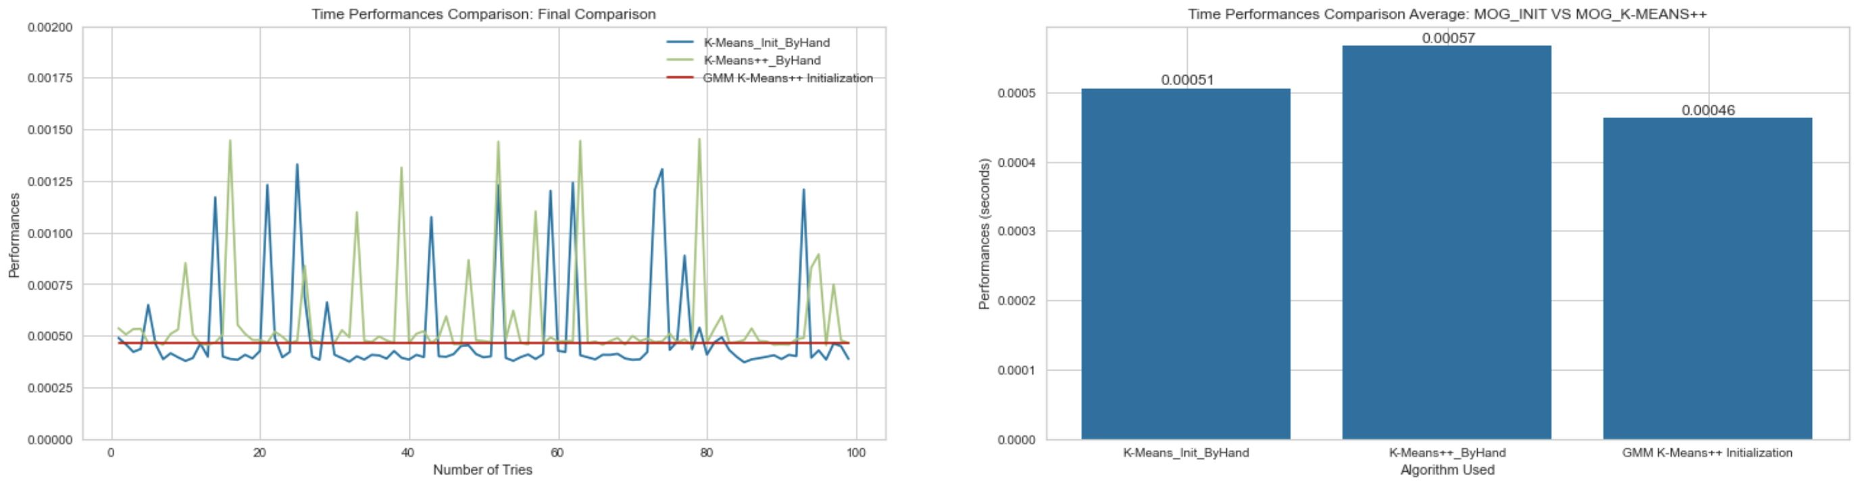
1.1: Clustering Idle VS Working
1.1.6: TIME PERFORMANCES: ALGORITHM COMPARISON
In order to find the fastest Algorithm, we first proceed in a sort of Pruning Step, in which we obtain the Fastest Algorithm for the three Categories: K-Means, K-Means++ and GMM.
IMPORTANT NOTE:
It is remarkable to say that, due to the Randomicity that is present in all the implementations, we have that the results will not always be the same. However, they follows always the same Hierarchy (in terms of speed). RESULT:
Here we will report the final result obtained.
K-Means: By-Hand - Elkan - Lloyd.
K-Means++: By-Hand - Elkan - Lloyd.
GMM: K-Means++ Init - Random Init.
As a last result, after this pruning step, we
Compare the three fastest algorithms, and
the GMM with K-Means++ Implementation
Turns out to be the fastest one.

Slide 15
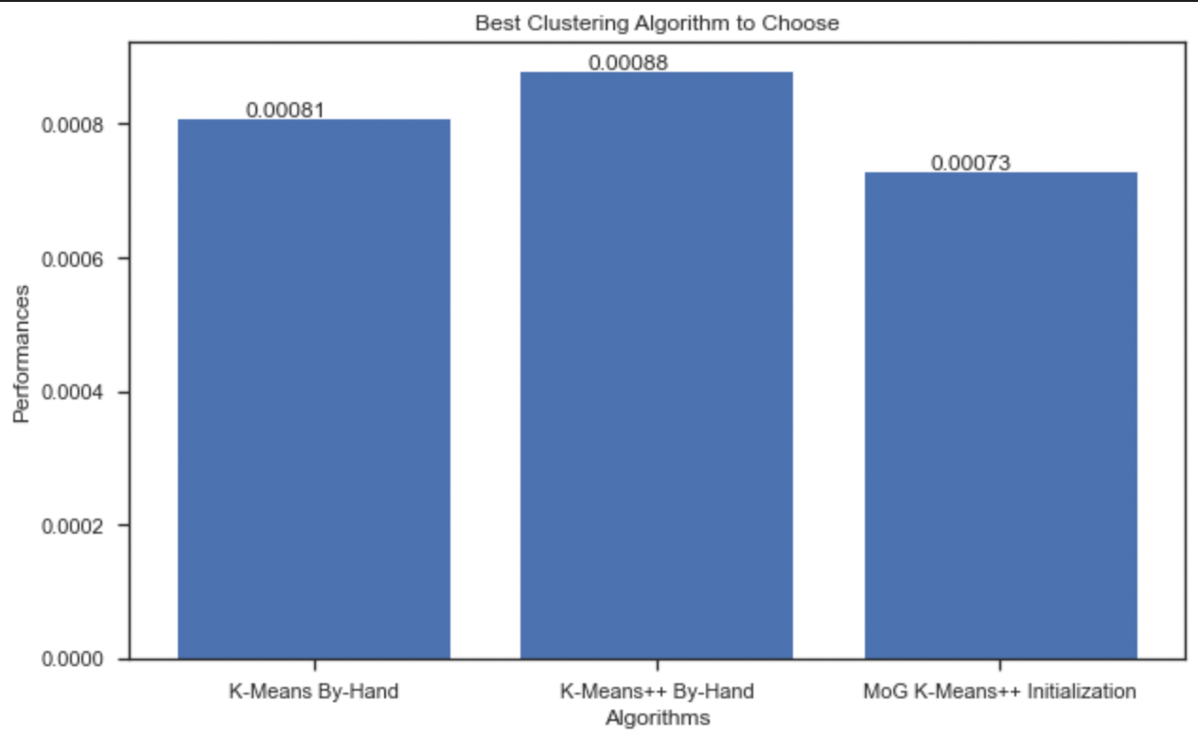
1.1: Clustering Idle VS Working
1.1.9 MIXED PERFORMANCES: BEST ALGORITHM TO CHOOSE
We now proceed in choosing what is the Best Clustering Algorithm to choose. We will choose it depending on Time Performances & Accuracy Performances.
PROBLEM:
However, the best Algorithm for Time, is the one that has the Fastest Timing (Smallest Value). For the Accuracy, we have the opposite: the best Algorithm is the one that has the Highest Accuracy (Biggest Value).
SOLUTION:
For the Accuracy, we first take "1 - Accuracy". In this way,
the Algorithm that has the Highest Accuracy Score,
will have the Smallest Value.
Scaling the Accuracy at the same level of the the Time. We
standardize it, by dividing it by 1000.
Adding the Standardized Result to the Time Performances.
The best algorithm to be chosen would be the one to have
the smallest Time+ [(1-Accuracy) / 1000] Value.
We therefore can conclude that the Best Algorithm is the GMM
with K-Means++ Initialization.

Slide 16
1.1: CONCLUSIONS
As Results of our Analyses we have performed over the Processor Component, we can conclude that:
We are now able to predict the State of the state of the PC given a new sample.
We have found out that the Best Algorithm to choose in our situation is the GMM with K-Means++ Initialization.

Slide 17
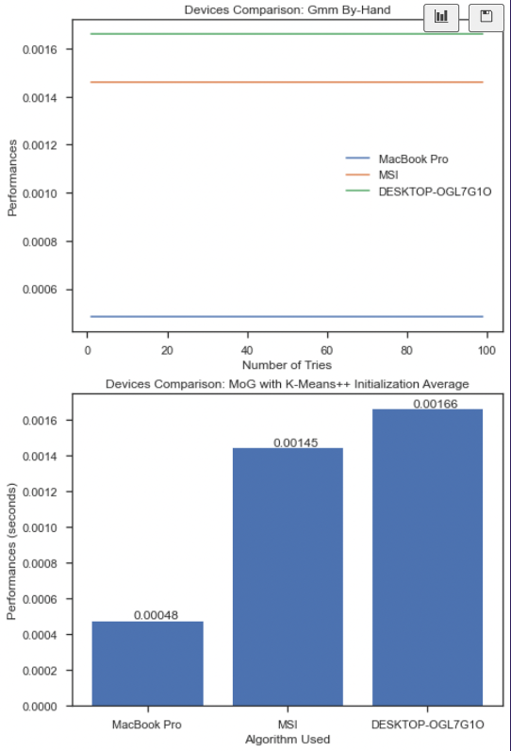
1.2: Time Performances: Devices Comparison
INTRODUCTION:
To continue our analysis on Processor, we now focus on Time Performances w.r.t. different algorithms implementations runned on different PCs environment. We will focus only on the three fastest algorithms found in the previous exercise, one for each category: the K-Means Implementation By-Hand, K-Means++ Implementation By-Hand, GMM with K-Means++ Initialization Implementation.
OBJECTIVE:
The aim of this analysis is to compare Algorithm Performances w.r.t. the different
Devices they are running on (MacBook Pro, Desktop OLG and MSI pc), in order to see
what is the fastest PC, and how much it is faster w.r.t. the other ones on running the
Clustering Algorithms.
DATA GATHERING:
For the Gathering of our data, we let our pc to run the three algorithms of interest over
100 tries and Save the result in a csv. At the end, we proceeded by unifying them is one
csv for algorithm. In fact, now we take the data from the three csv files.

Slide 18
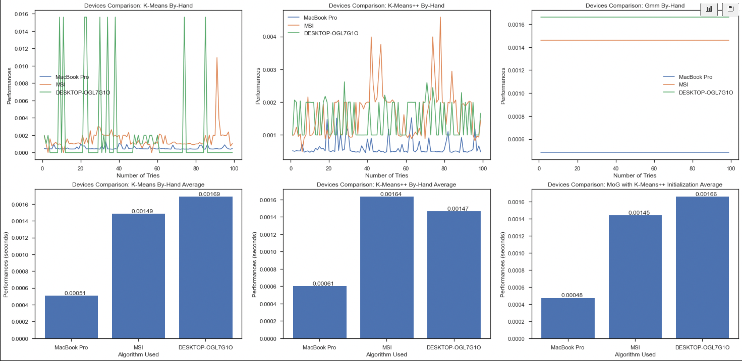
1.2: Time Performances: Devices Comparison
1.2.1 TIME PERFORMANCES: DEVICES COMPARISON RUNNED ALGORITHMS
Depending on the result obtained, we will then compute Empirically the Mean over 100 tentatives, and show up the result.
RESULT:
We have found that the Mac
Book Pro is way faster w.r.t.
the other two pcs.
In particular is faster with a
ratio of 3 : 1 w.r.t. the Second
One (that for the K-Means and
GMM case is the MSI, whilst for
the K-Means++ is the OLG.
Instead, w.r.t. the Third One,
the Mac Book Pro is faster with
a ratio of 3.5 : 1 .

Slide 19
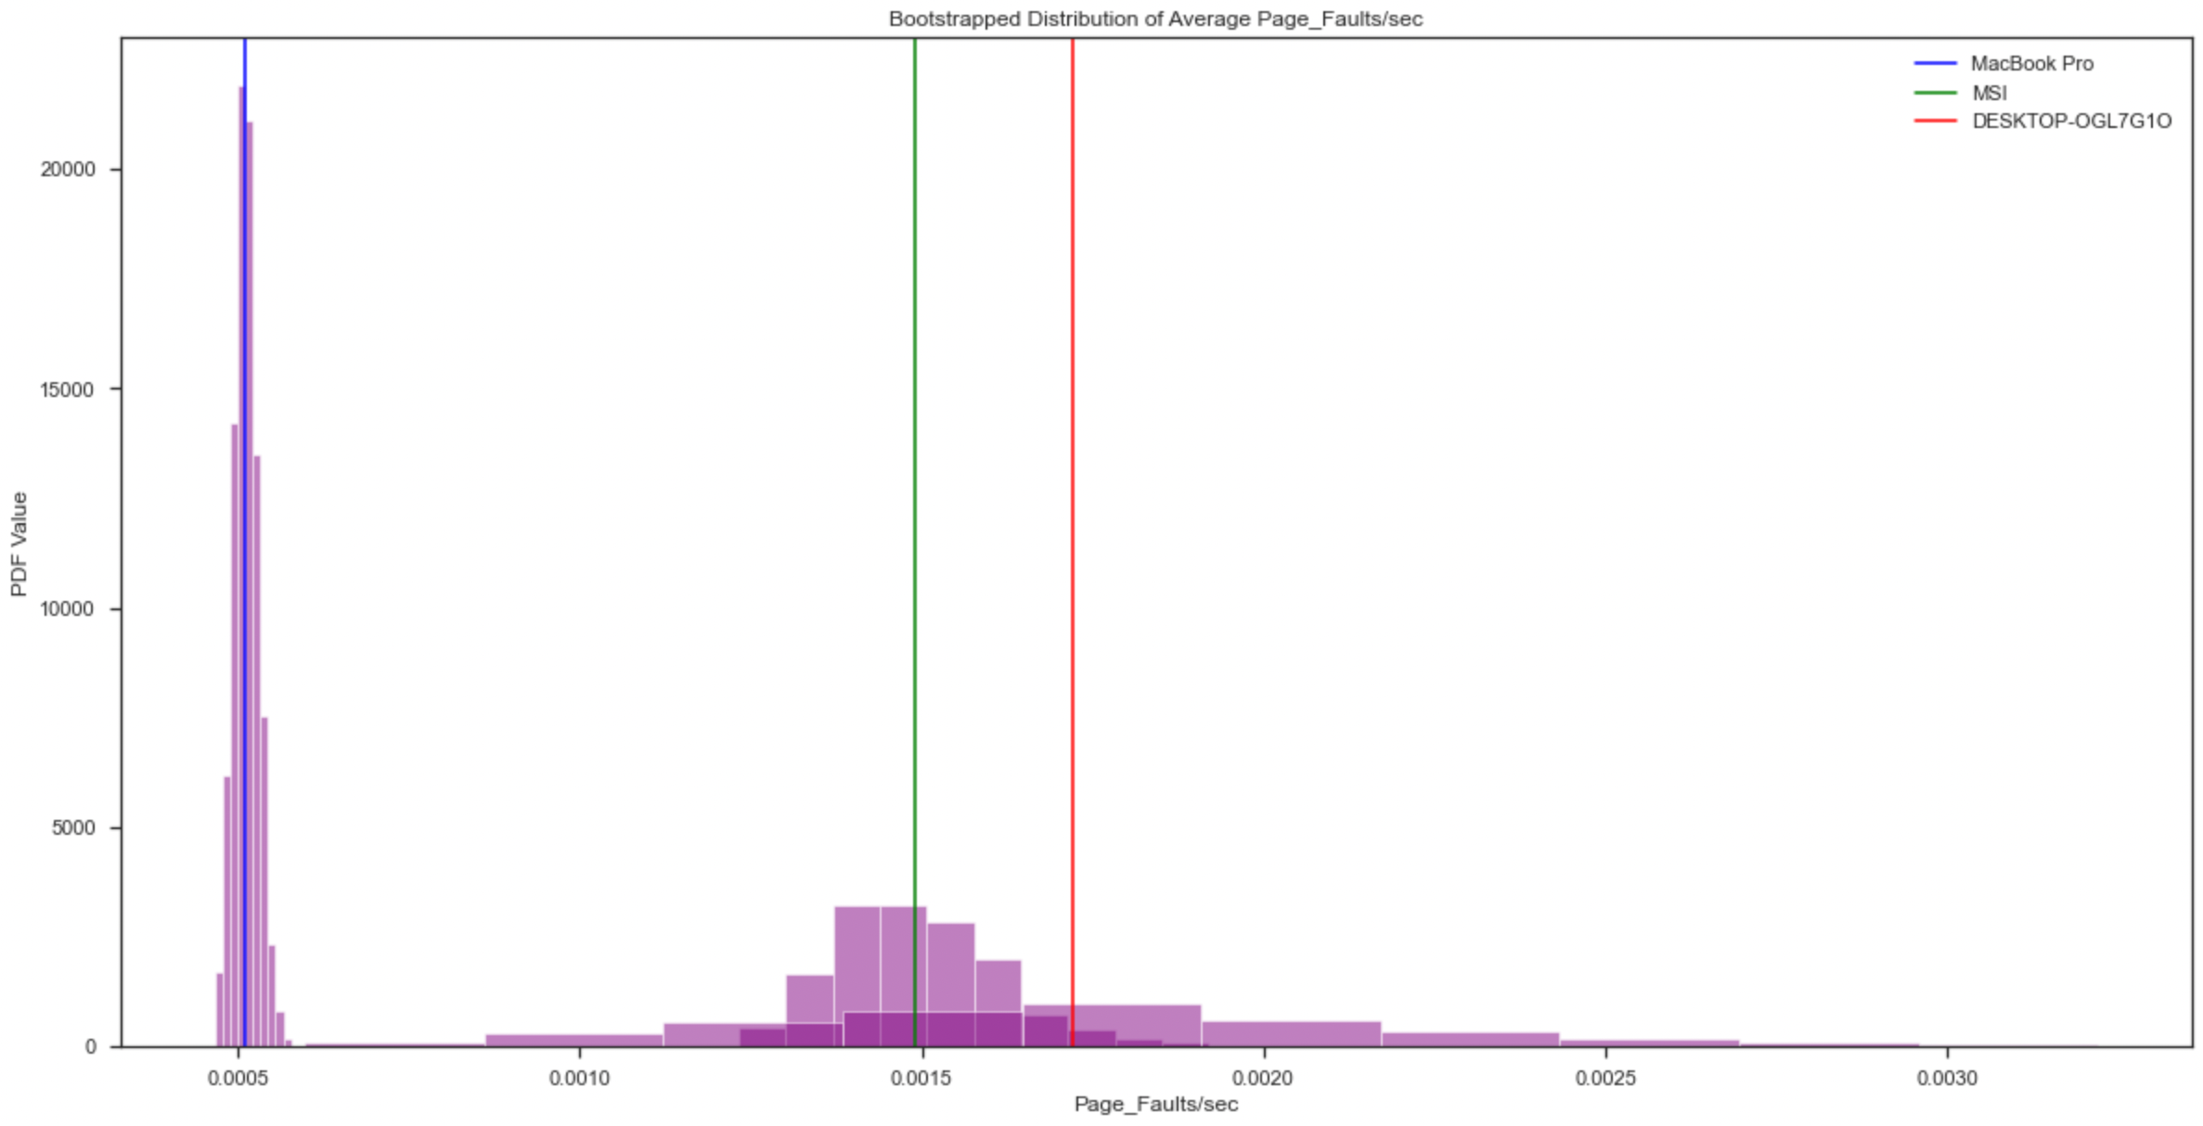
1.2: Time Performances: Devices Comparison
1.2.1.1: TIME PERFORMANCES DEVICES COMPARISON: K-MEANS NON-PARAMETRIC BOOTSTRAP
Implementation of a Non-Parametric Bootstrap, with the aim of seeing whether the Mean we have computed in the previous steps Empirically, can also be obtained with this statistical analysis.
IMPORTANT NOTE:
We are going to apply it, for only
the first case, namely the K-Means
By- Hand Implementation, and
not also for the other two, since we
use it only as a sort of proof that
what we are done is correct.
RESULT:
What we observe is that, when B
gets bigger and bigger, we are
going to get a result that
converges to the true empirical
mean.
+

Slide 20
1.2: CONCLUSIONS
At result of this second analysis, relatively to the
Different PCs, we have found that:
The MacBook Pro is way faster w.r.t. the other two pcs.
The second faster Pc is for the K-Means and GMM case, the MSI, whilst for the K-Means++ is the OLG.

Slide 21
02
MEMORY & PHYSICAL DISK
Page Faults and Cache Faults Analysis: Bootstrap & T-Test & Physical Disk Linear Regression

Slide 22
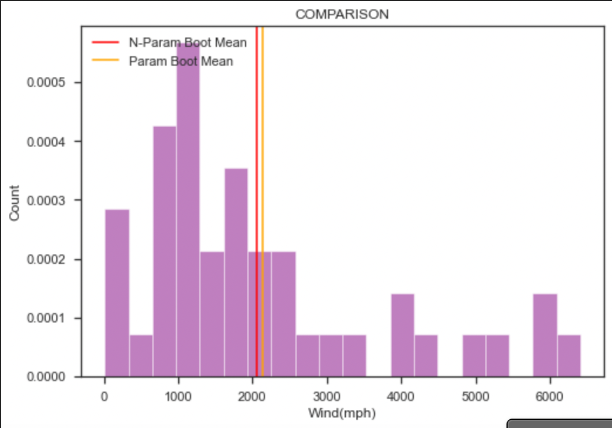
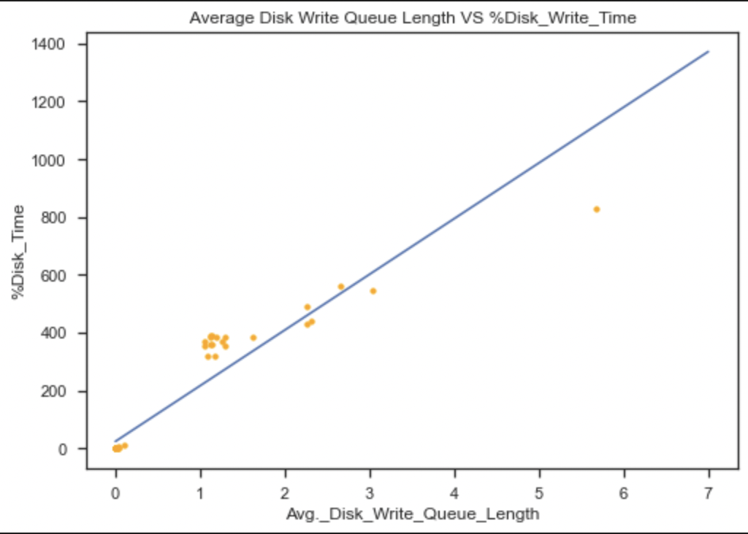
TASK EXPLANATION
The Memory is the second Component we are going to study. It is the storage area in which Programs are kept when they need to be Runned. It is faster w.r.t. the Physical Disk. It is subject to some Policy Replacements.
The Physical Disk is the third component we are going to study. It is the Primary Storage, used to store, retrieve and organize data. The most famous types are Hard Disks. Every data that is in the HD, must be flushed in the Memory if it wants to be executed.
TASKS:
In this second part of the Statistics Journey, we are going to perform on the Memory the following:
2.1 : Page Faults Analysis
2.2: Cache Faults Analysis
2.3: Physical Disk Analysis

Slide 23
2.1: Page Faults Analysis
INTRODUCTION:
For this Analysis, we focus our attention on Page Faults. At each logical memory reference, a page table lookup is performed. If the page is already present in the Memory, it is used, otherwise must be copied from the Physical Disk. This second situation, namely, the one for which the page is not in the Memory, is denoted as Page Fault.
In order, then, to flush the Page in the Memory, we need to implement some solutions for keeping track of the empty frames in the Memory, or we need to perform some Replacement Policy if all Frames are occupied.
OBJECTIVE:
The aim of this study is to find, on Average, how many Page Faults have occurred during the execution of a program. Then, we aim to find whether the average number of Page Faults is Equal for our Computers.
DATA GATHERING:
For the Gathering of our data, we let our PCs to be Monitored in a during the execution of a Python code (creation of an image with rectangles and shapes) followed by deletion of the same.

Slide 24
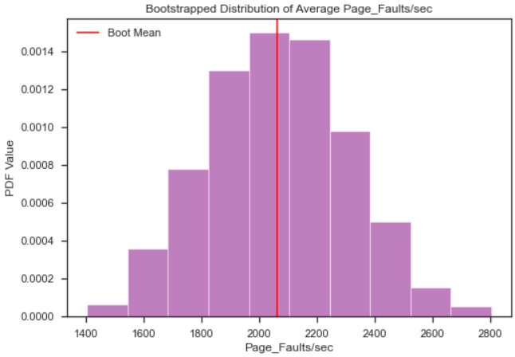
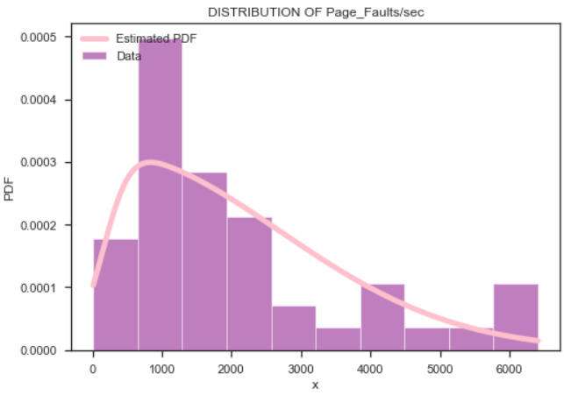
2.1: Page Faults Analysis
2.1.2: NON-PARAMETRIC BOOTSTRAP PAGE FAULTS' MEAN
We decided to compute the Mean of the many ‘page faults per seconds’ value collected, to understand how many of this time-costly operations are performed on average. To do so, our first approach was to use a Non-parametric Bootstrap.
The non-parametric Bootstrap has three stages:
1. Estimate the population (or probability) distribution from the data set
Simulate the sampling from the population distribution that led to the set of observations
For each sampling, calculate the sample statistic of interest.
2.1.3: PARAMETRIC BOOTSTRAP PAGE FAULTS' MEAN
We tried a parametric bootstrap implementation as well. We decided to use a skew normal distribution to approximate our data.
The procedure is the same as the non-parametric Bootstrap approach but for the distribution estimation stage: we selected the distribution type we believed the data to come from and then found the MLE parameters for that distribution.

Slide 25
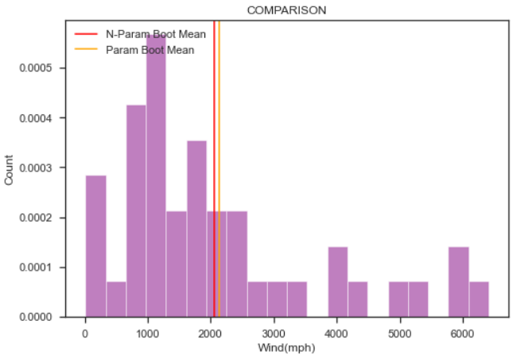
2.1: Page Faults Analysis
2.1.4: NON-PARAMETRIC vs PARAMETRIC SOLUTION To conclude our computation of the general ‘page faults per second’
mean, we plotted both parametric and not parametric bootstrapped
means to compare them.
2.1.5: ANOVA TEST
To test if the averages of the different computers were similar (between them and w.r.t the general one) e decided to perform a one-way Anova test on the means calculated on the three different devices.
It uses the following null and alternative hypotheses:
- H0 (NULL HYPOTHESIS): all the population means are equal.
- H1 (ALTERNATIVE HYPOTHESIS): at least one population mean is different from the rest.
2.1.6: COMPARISON ANOVA TEST AND NON-PARAMETRIC BOOTSTRAP SOLUTIONS
We computed the mean separately for each computer and, despite them being different, we could not reject the null hypothesis since: the p-value is greater than 0.05.

Slide 26
2.1: CONCLUSIONS
As Results of our Analyses we have performed over the Memory Component, we can conclude that:
We computed the Average Page Faults for each of our Computers and we can conclude that it does not result to be different (with Anova test comparison).

Slide 27
2.2: Cache Faults Analysis
INTRODUCTION:
For this Analysis, we focus our attention on Cache Faults. In nowadays computers, there is/are a sort of Support Memory, way faster and smaller w.r.t. the Memory, that has the role to contain the most used Pages. (80-20 % Rule).
Since the 80 percent of the time, we use the same 20 percent of data, we aim at using this Faster Memory when it is possible. We will have the same situation as with the Memory. If the frame we are requesting is not present in the Cache, we check whether it is present in the Memory, and if it is not, we flush it from the Physical Disk. When it is not present in the Cache, no matter whether it is in the Memory or in the Physical Memory, a Cache Fault is happening.
OBJECTIVE:
The aim of this study is to first compute the Average number of Cache Faults for each computer, and then go to see whether the Average number of Cache Faults is Equal for the PCs.
DATA GATHERING:
For the Gathering of our data, we let our PCs to be Monitored in a during the execution of a Python code (creation of an image with rectangles and shapes) followed by deletion of the same.

Slide 28
2.2: Cache Faults Analysis
2.2.1: GLOBAL COMARISON WITH ANOVA TEST
To check if the average of the cache faults of the three computers are equal, we first import the different datasets, then perform an Anova one way test. It uses the following null and alternative hypotheses:
- H0 (NULL HYPOTHESIS): all the population means are equal
- H1 (ALTERNATIVE HYPOTHESIS) : at least one population mean is different from the rest.
The Null Hypothesis has been rejected since the p-value is less than 0.05.
2.2.2: PC COMPARISON WITH T-TEST
After having performed a global test, we are interested in the average number of Cache Faults for each pair of PCs. Since they appear to be different (not all three are equal) we want to know if at least one of them has an equal average.
A two-sample T-test allows us to conclude that only a pair of PC "has the same behavior" . Basically only one of the three t-test does not reject h0, In the other cases, the null hypothesis is always rejected .

Slide 29
2.2: CONCLUSIONS
As a Results of our Analysis we have performed over the Memory Component, we can conclude that:
We computed the Average Cache Faults for each of our Computers and we can conclude that we could reject the null hypothesis since the p-value was less than 0.05.
Performing the t-test on each pair of PCs led us to the following: not all pc have the same cache faults mean, hence equal performance.

Slide 30
2.3: Physical Disk Analysis
INTRODUCTION:
For this Analysis, we focus our attention on the relation between:
%Disk Time: It is the percentage of elapsed time that the selected disk drive is servicing read requests or write requests.
Average Disk Write Queue Length: It keeps track of the number of write requests that are queued and waiting for a disk during the sample interval, as well as requests in service.
OBJECTIVE:
The aim of this study is to Find and, eventually, highlight a Relation between the two aspects. We also aim to try to foresee a new sample of this two attributes.
DATA GATHERING:
For the Gathering of our data, we let our PCs to be Monitored in a during the execution of a Python code (creation of an image with rectangles and shapes) followed by deletion of the same.

Slide 31
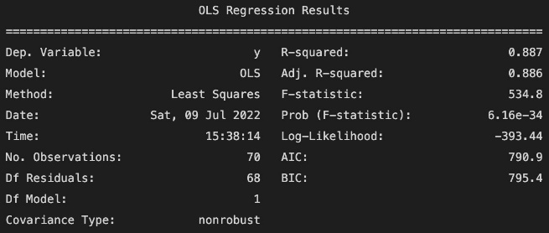
2.3: Physical Disk Analysis
2.3.1: FEATURES SELECTION
We started plotting a pair plot of all the features we tracked from our physical disk. We focused our attention on the relation between the Average disk write queue length and the '%Disk Time' that seem to have a great correlation and model two important aspects of that component.
The '%Disk Time' is the percentage of elapsed time that the selected disk drive is servicing read requests or write requests.
The Average Disk Write Queue Length tracks the number of write requests that are queued and waiting for a disk during the sample interval, as well as requests in service. As a result, this might overstate activity. If more
2.3.2: LINAR REGRESSION
To check if our assumption is correct we perform linear regression and check the R^squared value to see how well it fits our data.

Slide 32
2.3: CONCLUSIONS
As Results of our Analysis we have performed over the Physical Disk Component, we can conclude that:
We have found a very strong Relation between the two features, through the application of the Linear Regression. We get a high R_Squared value(a measure of how close the data points are to the fitted line).

Slide 33
03
CACHE & FINAL COMPARISON
Linear Regression with Cook Distance & Leverage Adjustments, Final Comparison with Correlation Matrix

Slide 34
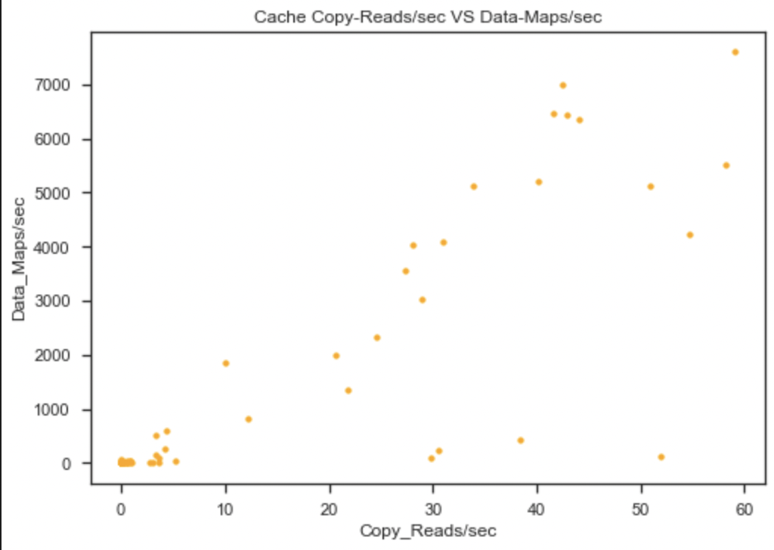
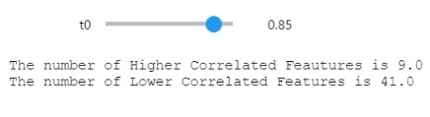
TASK EXPLANATION
The Cache is a place for hiding or storing things. It is a small amount of faster, more expensive memory used to improve the performance of recently of frequently accessed data. Cached data is stored temporarily in an accessible storage media that is local to the cache client and separate from the main storage. Cache decreases data access time and reduces latency. When a cache client attempts to access data, it first checks the cache. If the data is found there, that is referred to as a cache hit. The percent of attempts that result in a cache hit is called the cache hit ratio.
TASKS:
The last part of our Statistics journey is divided as follows:
3.: Cache Focus
4 : Final Comparison among different features of PC principal components

Slide 35
3 : Cache Focus
INTRODUCTION:
For this Analysis, we focus our attention on the relation between two very important aspects in the Cache:
Data Maps/Sec: It measures the frequency at which a file system maps a file page into the cache to read the page.
Copy Reads/Sec: It measures the frequency of reads from cache pages that involve a memory copy of the data from the cache to the application’s buffer.
OBJECTIVE:
The aim of this study is to find and, eventually, highlight a Relation between the two aspects. We are also interested in observations for which explanatory variables are far from their means, i.e. Points that have Highly Potential Influence on the least squares estimates. We want to look at how the model fit improves/changes, after deleting them.
DATA GATHERING:
For the Gathering of our data, we let our PCs to be Monitored in a during the execution of a Python code (creation of an image with rectangles and shapes) followed by deletion of the same.

Slide 36
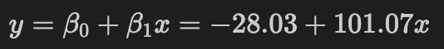
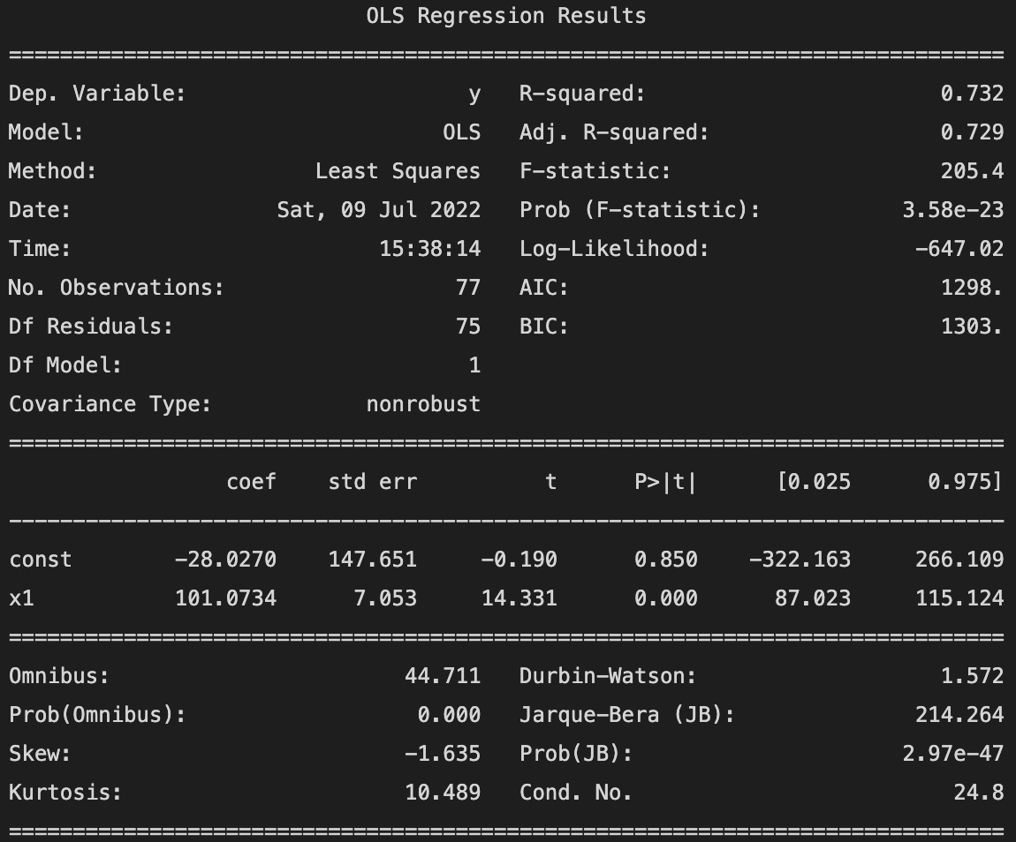
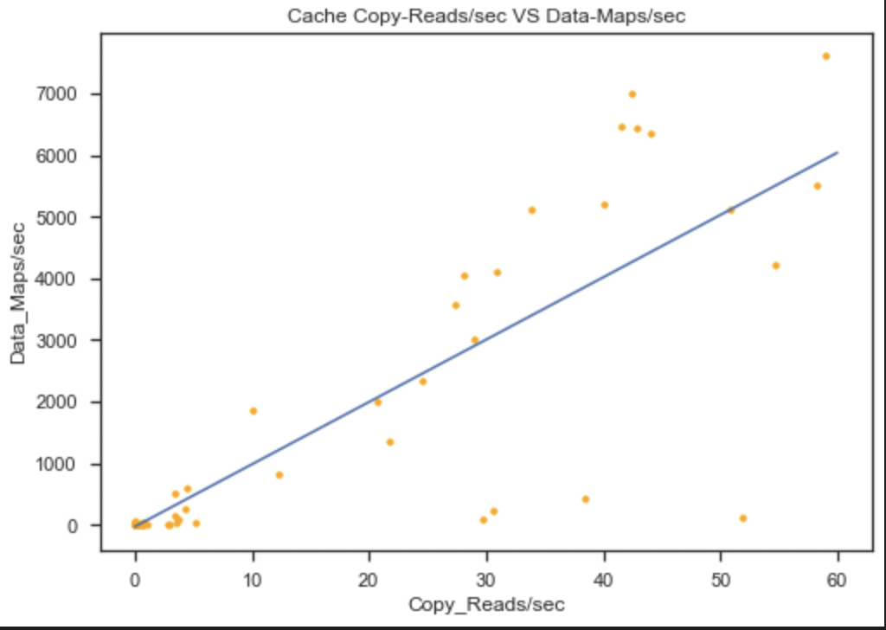
3: Cache Focus
3.1.1 LINEAR REGRESSION: COPY READ/SEC VS DATA MAPS/SEC As a first step, we check whether the Linear Regression is an appropriate model to describe the relation between 'Copy Reads/sec' and 'Data Maps/sec’.
RESULT:
As result of this try, we get an important R-Squared, that is, 0.732, approximating our data with a straight line, equal to:

Slide 37
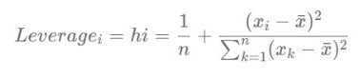
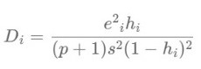
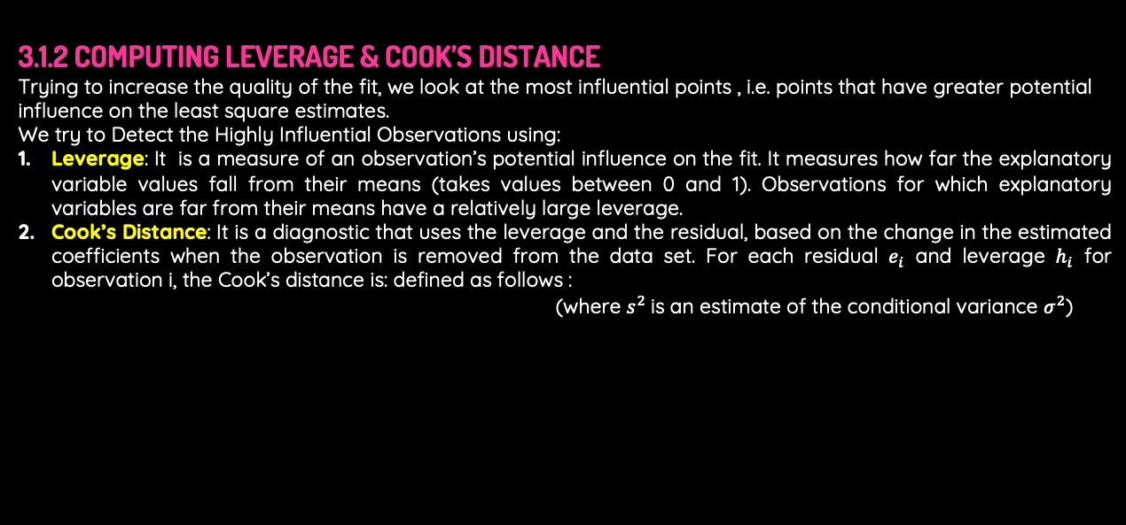
3 : Cache Focus
3.1.2 COMPUTING LEVERAGE & COOK’S DISTANCE
Trying to increase the quality of the fit, we look at the most influential points , i.e. points that have greater potential influence on the least square estimates.
We try to Detect the Highly Influential Observations using:
Leverage: It is a measure of an observation’s potential influence on the fit. It measures how far the explanatory variable values fall from their means (takes values between 0 and 1). Observations for which explanatory variables are far from their means have a relatively large leverage.
Cook’s Distance: It is a diagnostic that uses the leverage and the residual, based on the change in the estimated coefficients when the observation is removed from the data set. For each residual $e_{i}$ and leverage $h_{i}$ for observation i, the Cook’s distance is: defined as follows :
(where $s^{2}$is an estimate of the conditional variance $σ^{2}$)

Slide 38
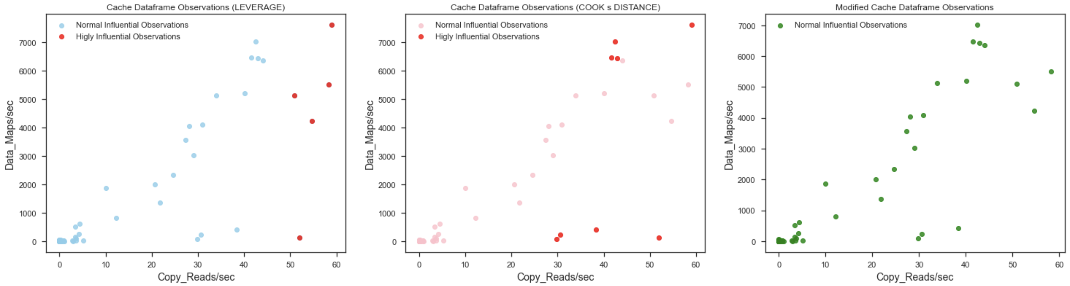
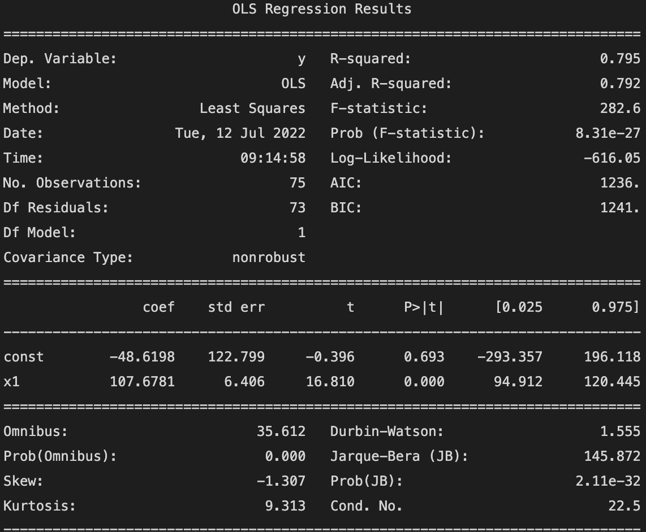
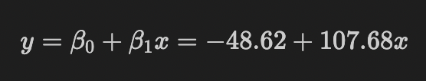
3 : Cache Focus
3.1.3: DELETING COMMON POINTS
We look at points that have the Highest Leverage and Cook Distances. The outliers found (denoted as ‘Common Points’) are removed from the Dataset. In order to check how the model fit changes/improves, we apply the OLS method again on the new Dataset.
At the end, the three plots represent, respectively, the leverage and cook distances for each point and the new Dataset (after having deleted the most influential points).
As we can see, deleting Common points increases the value of R-squared.
The higher it is, the better the fit is.

Slide 39

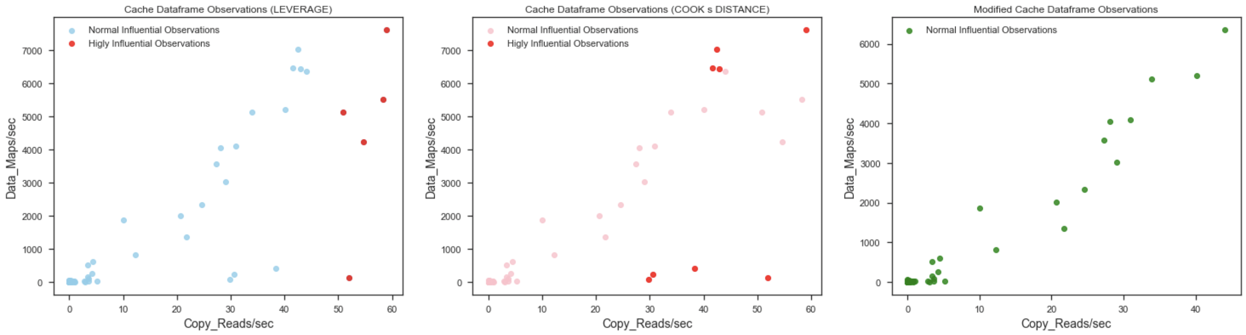
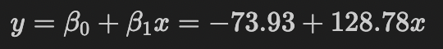
3 : Cache Focus
3.1.4: DELETING ALL THE POINTS
In the previous step, we have decided to eliminate only those points that have both a high leverage and cook distances. On the other hand, at this stage, we Delete ALL the Highly Influential Points from the initial Dataset (w.r.t. both distances).
In order to check how the model fit changes/improves, we apply the ols method again on the new Dataset. At the end, the three plots represent, respectively, the leverage and cook distances for each point and the New Dataset (after having deleted all the most influential points).
As we can see, removing all the most influential points lead us to high value
of R-squared.
However, a lot of points have been removed from the initial Dataset. For
this reason, we opt for the second-last model fit.

Slide 40
3: CONCLUSIONS
As Results of our Analysis we have performed over the Cache Component, we can conclude that:
We have found a very strong Relation between the two features, through the application of the Linear Regression. We get, at the end, after some corrections, a high R_Squared value(a measure of how close the data points are to the fitted line).

Slide 41
4 : FINAL COMPARISON
INTRODUCTION:
To end our project we decided to carry an analysis that uses all the previously shown datasets to find relations between features of different components. For that reason we decided to investigate on correlations between some of the most important between them that we selected. We ended the analysis showing also the less correlated features that seem to not influence each other.
OBJECTIVE:
The aim of this study is to find what are the Most Correlated Features among different datasets, assuming that the correlation reflects the influence that a feature has on other features and therefore it’s relevance in performance monitoring..
DATA GATHERING:
For the Gathering of our data, we let our PCs to be Monitored in a Working state. The Monitoring was taken during the execution of a Python code (creation of an image, design of rectangles on the image) for all the dataset except battery. For the latter dataset, the monitoring was taken watching a video.

Slide 42
4 : Final Comparison
4.1.1 COMPARISON DATASET:
We create a new Dataset selecting two of the relevant features for each PC component we are analyzing. Notice that, we have selected only two columns for each dataset, otherwise we would end up with a too big Dataset, that would capture aspects we may not be currently interested in.
4.1.2 CORRELATION MATRIX:
We compute the correlation matrix for each possible pair of features in the dataset using Non Parametric Bootstrap. It will tell what are the highest and lowest correlated features.
Through a widget, we display the number of highest and lowest correlated features for each possible value of the correlation.

Slide 43
4 : Final Comparison
4.1.3: HIGHEST AND LOWEST CORRELATED FEATURES
In this final step, we set an arbitrary high threshold (0.85) in order to look at the highest correlated features among those that we considered as some of the most relevant for a PC’s Performance Analysis. To perform that step we had to be careful to not take into account self- correlations. The following is the obtained result :
As a final step we also decided to find the features that were less correlated, the ones that have less influence on each other. We obtained:

Slide 44
4: CONCLUSIONS
As Results of our Analysis we have performed over all the Component, we can conclude that:
We have found the pairs of features that have the strongest correlations.
We have found the pairs of features that have the weaker correlations.

Slide 45

THANKS!
Alessio Borgi
Martina Doku
Giuseppina Iannotti

